Slide 1
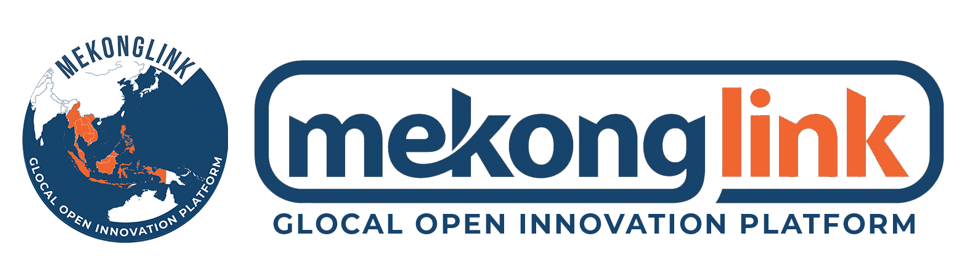
2025 TIPA TechBiz Exchange Program in HCM
Guideline
April, 2025

Slide 2

2025 GREEN TechBiz Exchange
(2025. April 15-17)

Slide 3
Program Overview
MEKONGLINK (Representative of 19 Korean Techno Parks), TIPA (Korea Technology and Information Promotion Agency for SMEs), KTR (Korea Testing & Research Institute) from Korea would like to hold “2025 Korea-Vietnam TechBiz Exchange Program in HCM”
10 promising technologies from Korea are looking for Vietnamese partners, especially SMEs who can develop Vietnamese market together. We hope to have practical cooperation opportunities for technology commercialization, global R&D projects, investment link, Know-how exchange, market expansion and network building with Vietnamese companies and organizations.
1. Event Title : 2025 Korea-Vietnam Green TechBiz Exchange Program in HCM
2. Participating Korean Companies & organizations : 10 technologies from Korea, TIPA, KTR
3. Place: SaiGon Prince Hotel - 63 Nguyen Hue, Ben Nghe, District 1, Ho Chi Minh City
4. Date and Schedule : April 16, 2025
5. Registration link: https://forms.gle/Z1QVkS8JbUiock128
6. Brochure link: https://drive.google.com/drive/folders/15dmDzP-AudvSXbU9ymZLcBbH0cExX5oR?usp=sharing

Slide 4
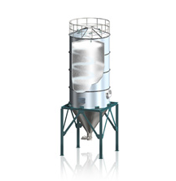
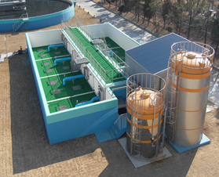
Tech#1: ILSHIN
Website: http://okilshin.co.kr/
Main technology: Advanced Water Treatment Solutions
IEO (Innovative Eco-Oxidant) Eco-friendly Advanced Oxidation Agent
IECO (Innovative Electro-Chemical Oxidation) Adsorption Electrochemical Oxidation Technology
IPR (Innovative Phosphorus Removal)
MRI-PS Top Tube Orifice Inclined Plate Sedimentation Device
USP
Integrated solutions for wastewater, air pollution, and plant engineering in one system.
Customizable & modular designs for various industrial needs.
Cost-effective technologies with high efficiency & minimal operational maintenance.
Supports ESG & carbon neutrality goals with sustainable environmental technologies.
Expected Business Partners:
Municipal wastewater treatment facilities;
Waste treatment companies: Power plants, chemical & semiconductor manufacturers
Industrial waste treatment: Cement, steel, and food processing industries
Companies implementing carbon neutrality & sustainability strategies
Matching Keywords:
Ferrate(VI), Recalcitrant wastewater, Electrooxidation, Perfluorinated compounds, HFO Coating, SS separation and sludge collection
Water treatment, industrial waste treatment, water pollution.
Brochure link: Click here

Slide 5
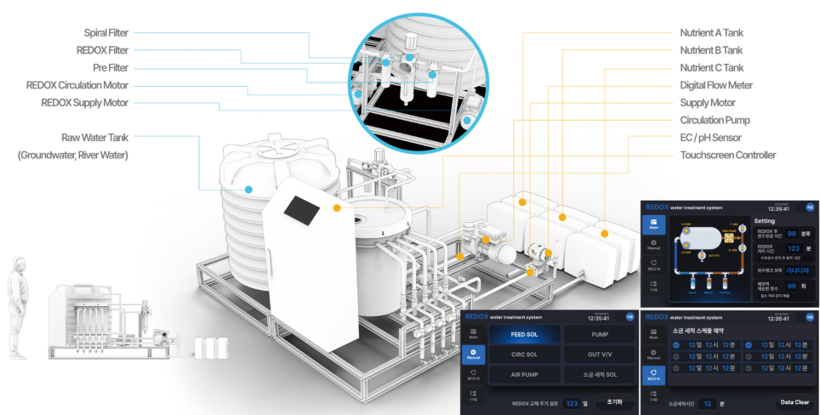
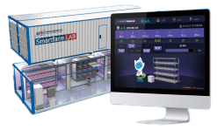
Tech#2: N Information Technology
Website: http://www.ntek.co.kr/
Main technology: Redox-based Water Treatment System (REDOX is a compound word of REDUCTION & OXIDATION, referring to oxidation/reduction reactions.)
Technology to remove viruses, algae, heavy metal substances, and other pollutants in water resources using REDOX reaction
Treatment of algae and harmful substances contained in agricultural water, purification of polluted factory wastewater, etc
USP
Sterilization of fungi and reduction effect on water pollutants and harmful substances with a single system.
Minimizing additional work (removal of scale-causing substances) on existing equipment (pipes, etc.) when introducing the system.
Schedule control possible through automatic control system.
Expected Business Partners:
Hydroponics Smart Farming & Agriculture Companies
Research institute or universities who are in hydroponics smart farming
Agricultural & Environmental Wastewater Treatment Companies
Matching Keywords:
Smart Farming & Hydroponics; REDOX Water Treatment;
Brochure link: Click here

Slide 6
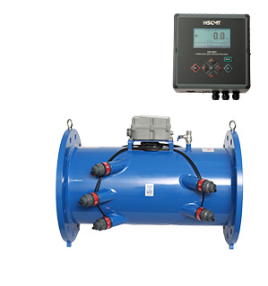
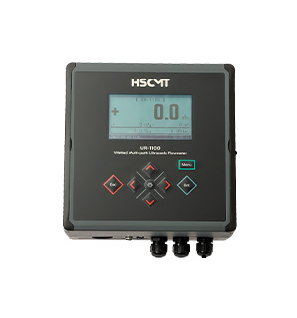
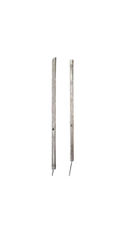
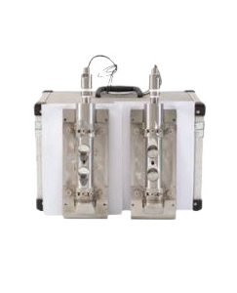
Tech#3: HSCMT
Website: http://www.hscmt.co.kr/page/s0401.php
Main technology: Multi-line ultrasonic flowmeter capable of precise flow measurement through improved automatic zero point, line distance, and flow velocity measurement methods
Real-time flow rate and integrated flow measurement (data sampling in 1-second units)
Application of non-shutdown direct construction method (easy flowmeter replacement and maintenance)
USP
Automatic zero point adjustment technology
Improvement of line distance and flow velocity measurement method
Expected Business Partners:
Related to calorimeters for district cooling and heating
Flowmeters and water meters for water management
Water meters and calorimeters for home use
Water supply management network and energy supply network system
Matching Keywords:
Multi-line ultrasonic flowmeter
Precision flow measurement
Brochure link: Click here

Slide 7
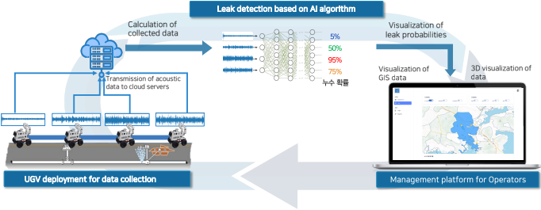
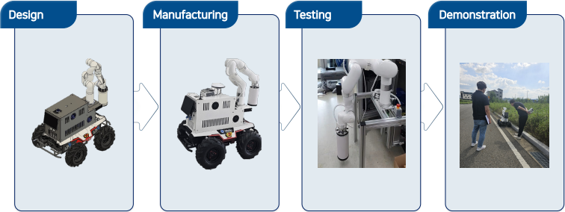
Tech#4: Floworklab
Website: https://floworklab.com/
Main technology: UGV (Unmanned Ground Vehicles) & AI for Water Leakage Detection
This solution is an integrated full-cycle system for water pipe network leakage management, combining hardware (HW) and software (SW).
It supports efficient and rapid leakage management by automating all processes from automatic identification of leakage suspected areas, precise exploration, repair work plan establishment, water outage area prediction, and user notification.
USP
This solution achieves high detection accuracy of over 95%
Dramatic Reduction in Maintenance Costs Compared to Fixed Sensors
User-Centered Design for Easy Use Even by Non-Experts
Provides Industry's Only Automatic Water Outage Prediction and Repair Plan Establishment Function
Expected Business Partners: SAWACO
Water Pipe Management and Maintenance service providers
Digital Twin for water supply management
Water supply management in Industrial Parks, Factories, Smart cities, Resorts, Tourist complex, etc
Matching Keywords:
Water Leakage Detection, Water Pipeline Inspection, Digital Twin
Water supply management; GIS-Based Leak Monitoring
Brochure link: Click here

Slide 8
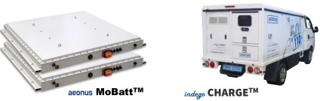
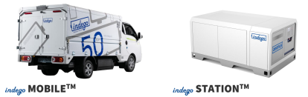
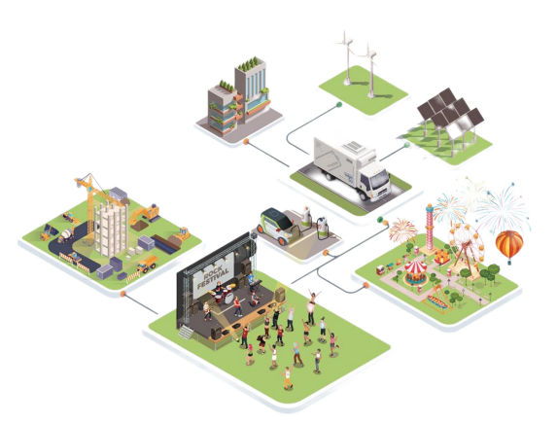
Tech#5: AEONUS
Website: http://aeonus.co.kr/main
Main technology: Mobile Energy Storage Solution (ESS)
Mobile ESS for large-scale power supply, such as electric vehicles, outdoor events, festivals, disaster sites, and construction sites.
Electric Vehicle Charging: Provides portable fast charging for electric vehicles.
USP
Mobile ESS: Provides both generator and ESS functionality, supporting renewable energy.
Zero Emissions: Environmentally friendly, carbon-neutral solution.
Flexible: Easy to deploy and expand.
Expected Business Partners:
EVN (Electricity Vietnam)
Renewable energy & power grid operators
EV manufacturers & fleet management companies
Battery recycling & second-life energy storage providers
Smart city & green infrastructure developers
Matching Keywords:
Construction, infrastructure, and power grid operation companies
EPC (Engineering, Procurement, and Construction) contractor
Energy Storage System (ESS); EV Battery manufacturer
Universities and institutes studying ESS & renewable energy fields
Brochure link: Click here

Slide 9
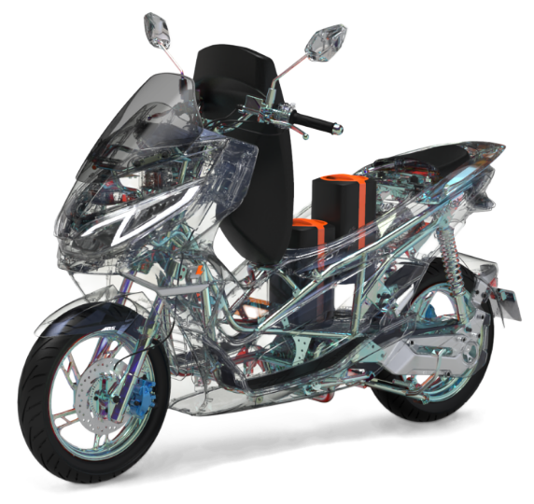
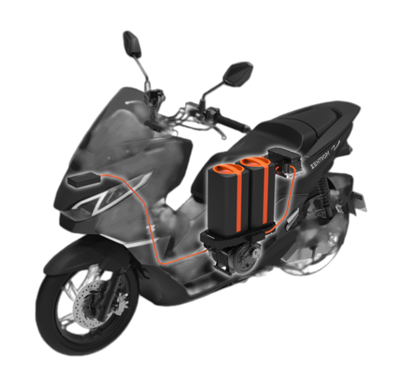
Tech#6: ZENTROPY
Website: https://www.zentropy.co.kr/en
Main technology: Electric Motorcycle and Battery Swapping platform
Electric Motorcycle: Electric motorcycle technology with replaceable batteries, suitable for personal use and cargo transportation.
Monitoring System: Management of motorcycles and battery replacement stations through a monitoring system.
USP
High Performance: Maximum speed of 100 km/h, high durability certified in Korea.
20-second battery swap technology vs. 4-hour traditional charging
Extends battery life by repurposing EV batteries
Reduces CO₂ emissions by replacing fuel-based motorbikes
Expected Business Partners:
Electric Motorcycle Manufacturers
EV battery swapping system developers
Battery Recyclers & Recycled Energy Storage Companies
Universities and institutes studying electric motorbikes and related technologies
Matching Keywords:
Electric Motorcycle Manufacturer
Battery Swapping Station, Battery Sharing Solution
Smart Batteries for Motorcycles
Brochure link: Click here

Slide 10
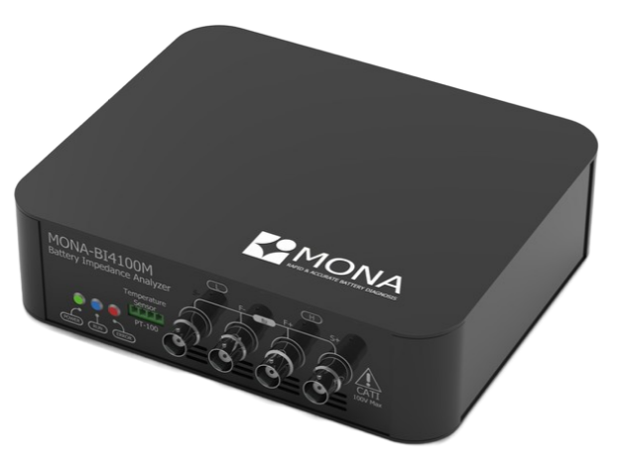
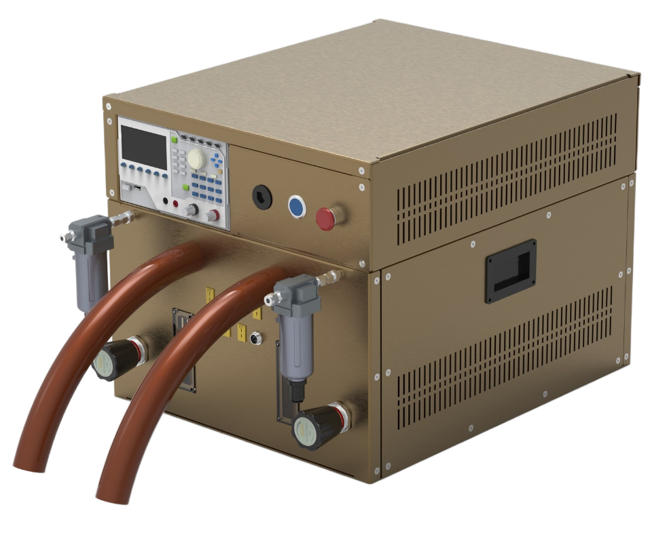
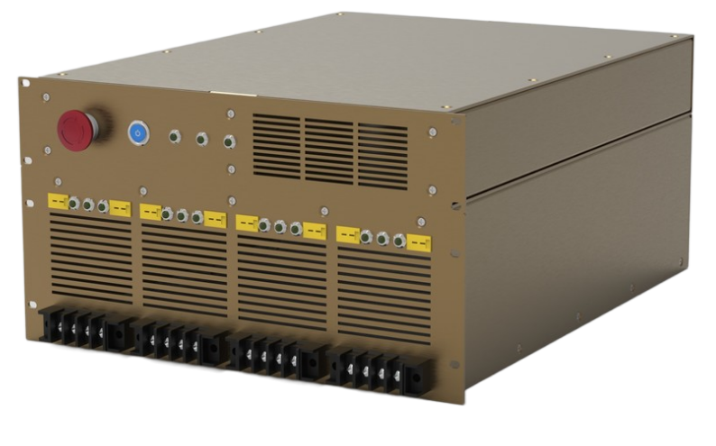
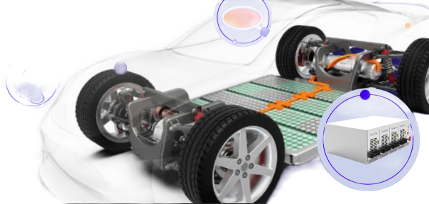
Tech#7: MONA
Website: https://monaelec.com/
Main technology: Battery Cell Diagnostic System Using Impedance Technology
It is capable of solving the problems of battery explosion, battery life reduction and battery quality problems by applying ultra-small AC signals to the battery.
Super-speed measurement technology, reducing the measurement time from several minutes to several hours to several seconds.
USP
Fast and Accurate Testing: Reduce measurement time from 5 minutes to 5 seconds.
Detailed Analysis: Use EIS (Electrochemical Impedance Spectroscopy) to analyze key battery components.
Big Data: Collect and analyze battery data to predict performance and quality.
Expected Business Partners: Vinfast
EV manufacturers & battery suppliers
Battery recycling & reconditioning businesses
Electric Motorcycle Manufacturers
Universities & Institutes studying EV Battery diagnostics solution
Matching Keywords:
Battery diagnostics solution
EIS (Electrochemical Impedance Spectroscopy) Battery diagnostics
Brochure link: Click here

Slide 11
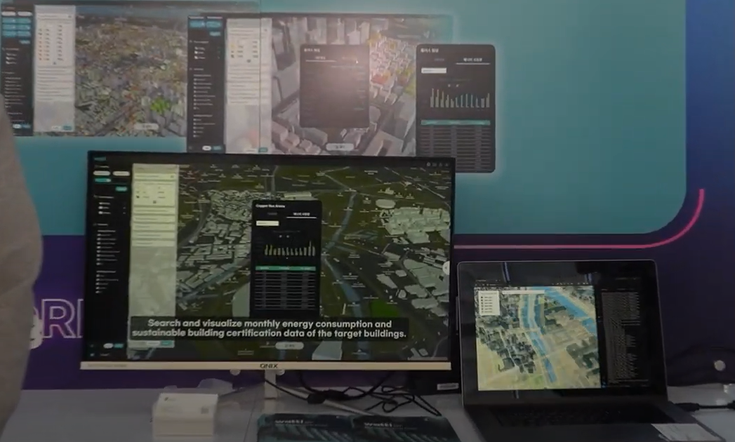
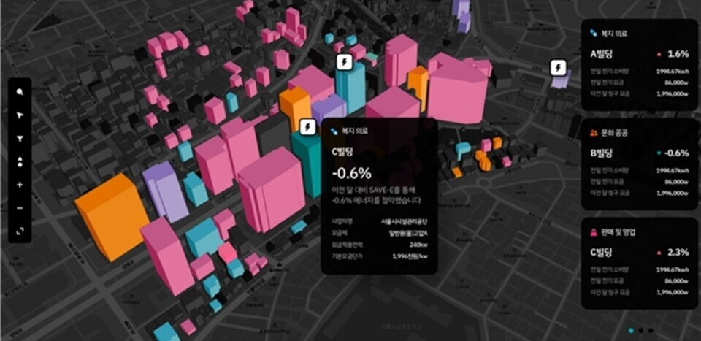
Tech#8: NINEWATT
Website: https://ninewatt.com/main
Main technology: Mesh Network-Based LED Control Device and Management System (B2B Factories, Facilities, Buildings)
Mesh Network Technology: Enables large-scale smart lighting deployment without the need for an Internet connection.
Compatible with Existing LEDs: No need to replace the current LED lighting system, only requires an additional IoT intermediary device.
Real-Time Monitoring: Tracks energy consumption and efficiency savings.
USP
Mesh Network technology helps control large space without wifi.
No LTE/Wifi data cost.
Fast and easy installation with QR registration system, reducing costs, time and technical requirements.
Expected Business Partners:
Real Estate Management Companies & Smart City Projects
Government agencies manage energy reduction initiatives
Consulting company on energy efficiency, installation, control of smart lighting
Matching Keywords:
LED installation service, energy management of building, factory
Brochure link: Click here

Slide 12
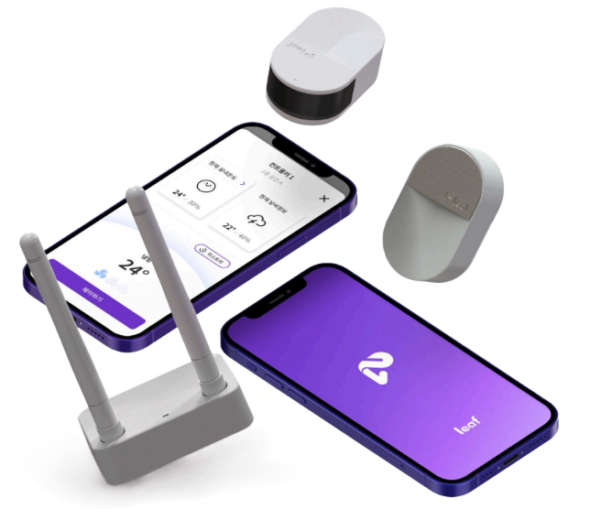
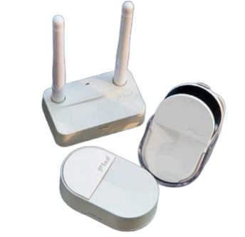
Tech#9: SeedN
Website: https://www.seedn.co.kr/
Main technology: AIoT Energy Management System (Leaf AI)
an intelligent temperature and energy optimization solution designed for buildings, factories, retail spaces, and commercial facilities. It automatically controls heating, ventilation, and air conditioning (HVAC) systems to improve energy efficiency, reduce electricity costs, and lower carbon emissions.
USP
Automatically adjusts temperature based on user location, weather, and spatial data.
Optimizes air conditioning usage for each zone to minimize energy loss.
AI-powered learning technology continuously improves heating and cooling efficiency.
Expected Business Partners:
Large air conditioner brands in Vietnam: Daikin, Toshiba, Sharp, LG.
POC with office buildings to verify effectively.
Expanded to shopping malls, retail stores.
Application for cold & logistic storage systems.
Matching Keywords:
Smart energy management, building and factory energy management
Brochure link: Click here

Slide 13
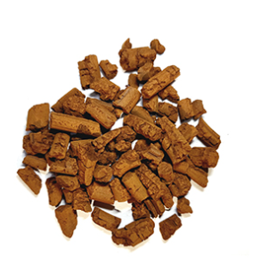
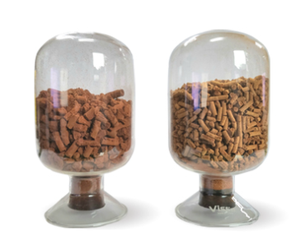
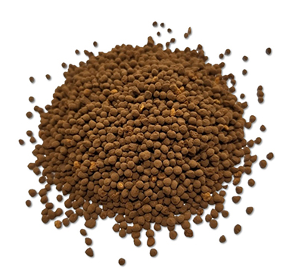
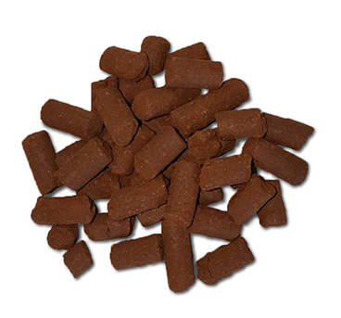
Tech#10: E&CHEM SOLUTION
Website: http://eng.enchem.co.kr/
Main technology: Desulfurization Agent and Biogas and Odor Desulfurization System
Desulfurization Agent: A desulfurization agent based on iron hydroxide, characterized by its amorphous and porous nature, capable of removing more than 99.9% of hydrogen sulfide.
Dry Dehumidification and Desulfurization System: Maximizes removal efficiency by passing dehumidified biogas through a desulfurization tower filled with iron hydroxide-based desulfurization agent.
USP
Over 97% methane purity with less than 3% loss
99.9% removal of H₂S & Siloxane contaminants
Low-cost & high-efficiency CO₂ capture
Expected Business Partners:
Same company like ACE Construction Environment Co., Ltd; EGREEN, etc.
Organic waste treatment facilities (anaerobic digestion), landfill facilities, and odor-generating facilities, Biogas pretreatment, solid waste treatment equipment
Visit the Advanced Materials and Environment Center in Vietnam
Matching Keywords:
Organic waste treatment, preliminary treatment of biogas, solid waste treatment equipment, odor treatment,
Brochure link: Click here

